Slide 1
SECURE DATA HIDING IN IMAGE USING STEGANOGRAPHY
CAPSTONE PROJECT
Presented By
Student Name : Kotakommala Charan Teja
College Name & Department : Gate College & Masters in Computer Science

Slide 2
OUTLINE
Problem Statement
Technology used
Wow factor
End users
Result
Conclusion
Git-hub Link
Future scope

Slide 3
Problem Statement
The Need for Hidden Communication:
Securely exchange information without attracting attention.
Protect sensitive data from unauthorized access.
Maintain confidentiality in environments where encryption might be prohibited.
Why Steganography?
Advance security by hiding the existence of data.
Confidential communication and secret data storing.
Protection of data alteration.

Slide 4
Technology used
Programming Language: Python
Libraries:
OpenCV (cv2): For image processing (reading, writing, and manipulating images).
OS: For interacting with the operating system (e.g., file operations).
Steganography Technique: LSB (Least Significant Bit)
Embeds message by modifying the least significant bits of pixel values.
Minimizes overall image distortion.
Image Format: (Recommend JPG ,PNG)
Lossless compression is crucial to avoid data loss.

Slide 5
Wow factors
Hiding in Plain Sight:
Demonstrate how a secret message can be imperceptibly embedded within an ordinary image.
Show the original and stego images side-by-side to highlight the minimal visual difference.
Practical Application:
Illustrate the potential for secure, covert communication.

Slide 6
End users
Who Benefits?
Anyone needing to transmit sensitive information discreetly.
Journalists, activists, and individuals in countries with censorship.
Organizations requiring secure internal communication.
Examples:
Secure messaging applications.
Copyright protection (watermarking).

Slide 7
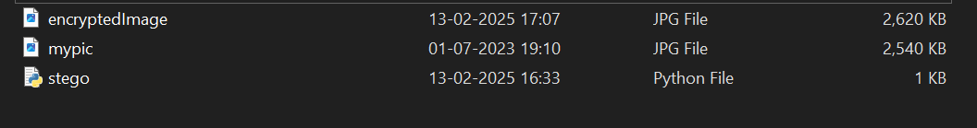
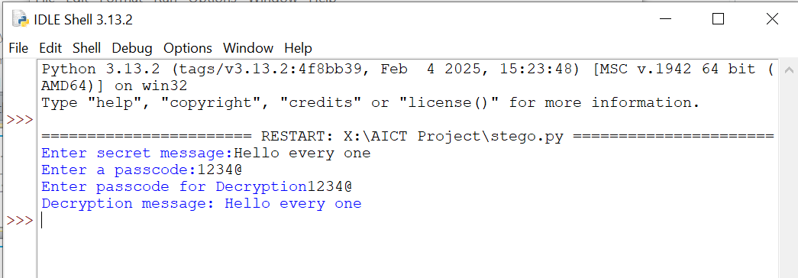
Results
Working Steganography System:
Successfully encrypt and decrypt messages within images.
Demonstration:
Show a live demo of the project.
Encrypt a message, decrypt it, and display the results.
Metrics (Optional):
Embedding capacity (how much data can be hidden).
Perceptual quality metrics (e.g., PSNR) to quantify image distortion

Slide 8
Conclusion
Steganography Achieved:
The project successfully implemented a basic image steganography system.
Limitations:
Basic LSB steganography is not highly secure.
Vulnerable to steganalysis (detection of hidden messages).
Limited embedding capacity.

Slide 9
GitHub Link
https://github.com/kcharanteja/AICTE-Project-CS-.git
Above link is project GitHub repository.

Slide 10
Future scope(optional)
Enhanced Security:
Implement more advanced steganography techniques.
Explore adaptive LSB methods or transform domain techniques.
Integrate with robust encryption algorithms (e.g., AES) for added security.
Increased Capacity:
Develop methods to hide more data within images.
Utilize multiple color channels or more sophisticated embedding strategies.
Steganalysis Resistance:
Research techniques to make the steganography more resistant to detection.
Applications:
Develop specific applications for secure communication or copyright protection.

Slide 11
THANK YOU

